Slide 1

Meetings & Conventions
Kalahari Resorts & Conventions – Pocono Mountains, PA

Slide 2
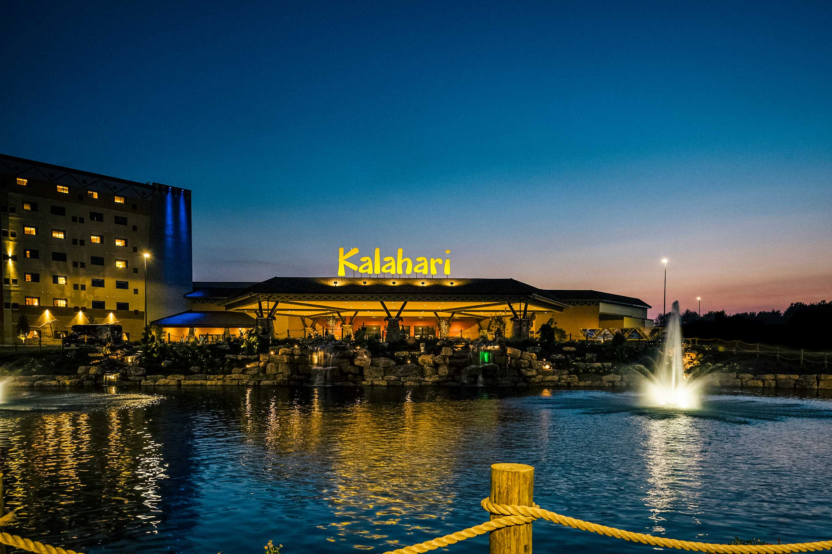
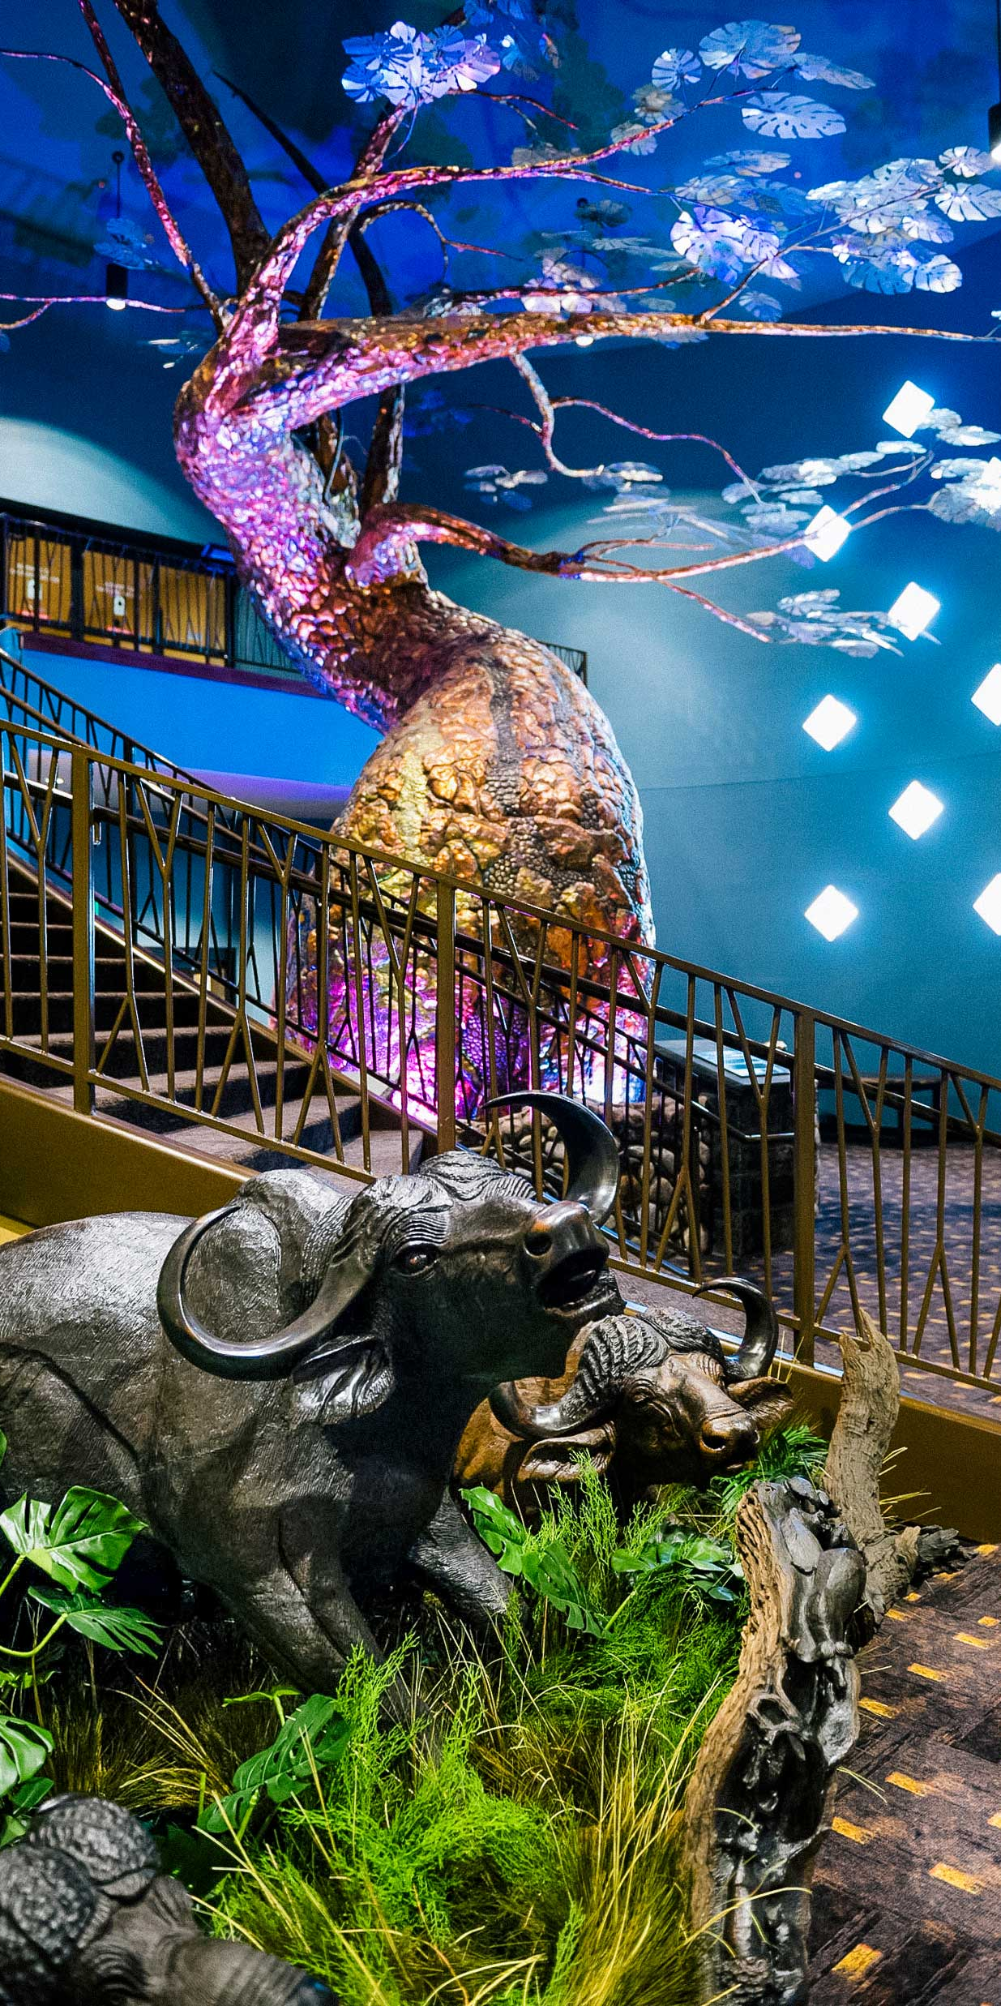
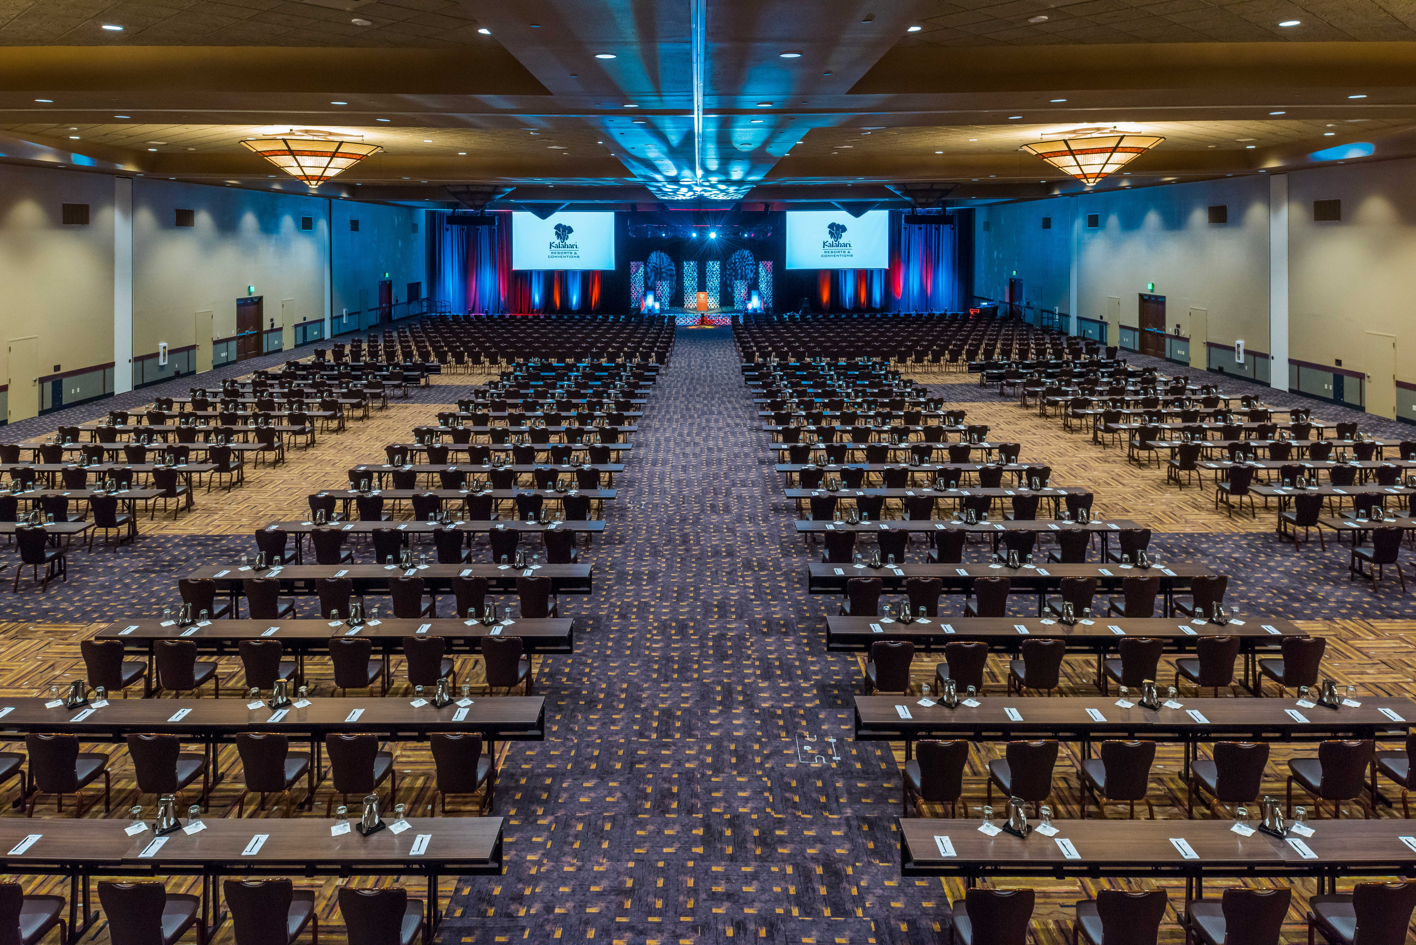
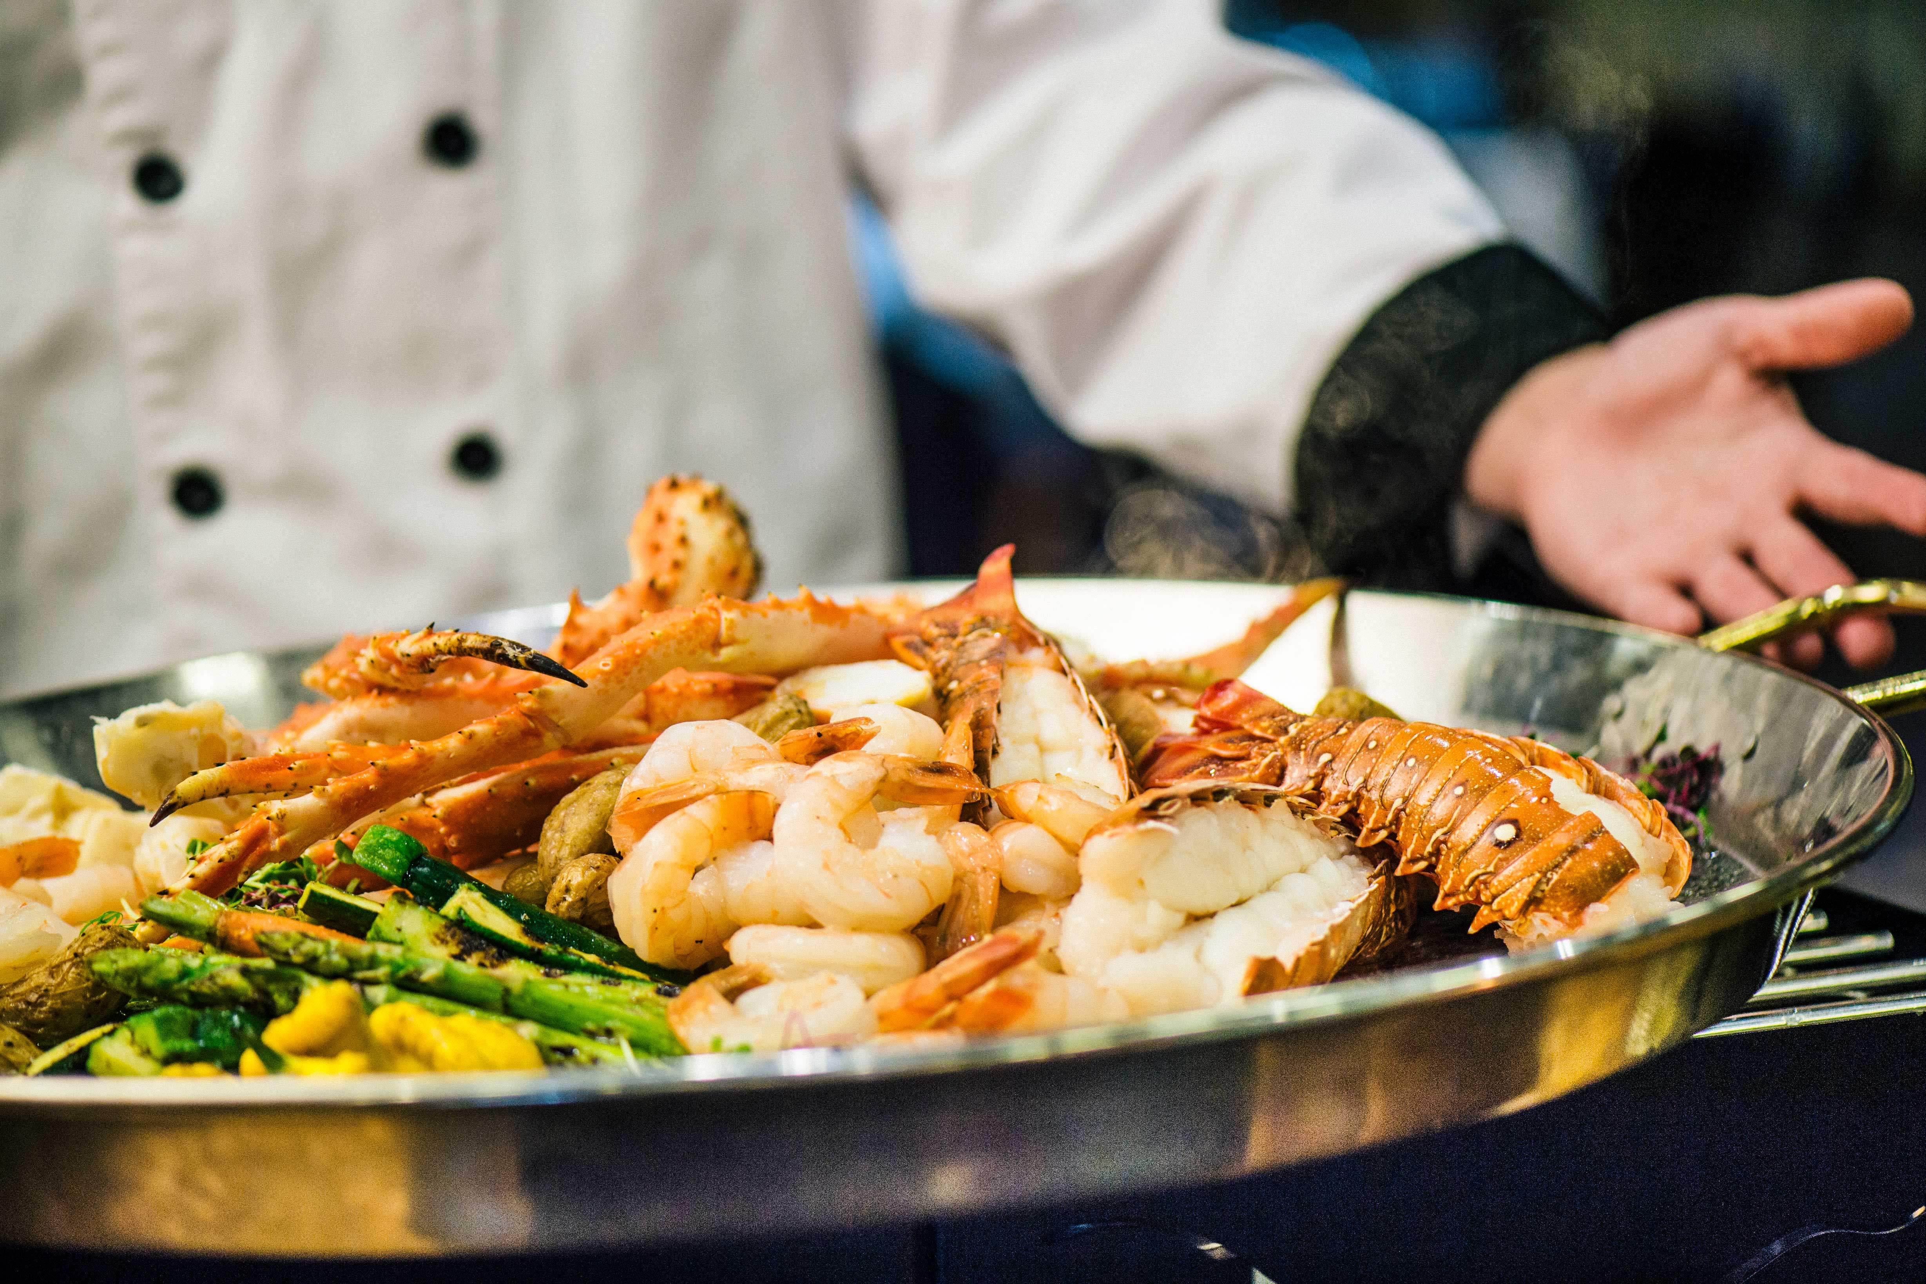
Who We Are
Kalahari Resorts & Conventions is an African-inspired resort and convention center offering a premier all-under-one-roof experience for meetings and events of any size. Inspired by the beauty, culture, and spirit of Africa, our resort is designed to bring people together
for unforgettable getaways and exceptional events.
Our Features
Guest Rooms
Premium Dining
Customizable Meeting Spaces
America’s Largest & Best in Family-Friendly Amenities

Slide 3
Guest Rooms
977 Guest Rooms & Suites
1-to-5 Bedroom Suites
Including Penthouse & Big 5 Suites
Whether you're traveling alone or with a group of 22 (yup, 22!), we've got you covered.
All rooms include a microwave, coffee maker, refrigerator, iron, ironing board, in-room safe, complimentary Wi-Fi, remote control television with cable, alarm clock, voicemail system, hair dryer, and luxurious bath amenities.

Slide 4
Hundreds of Flavors
All-Under-One-Roof
We've got something to satisfy every taste, from steak houses to ice cream shops. You'll never have to eat in the same spot twice, but you just might want to.
Double Cut Steak House
Received 2025 OpenTable Diners’ Choice Award
Sortino’s Italian Kitchen
Received 2025 OpenTable Diners’ Choice Award
Redd’s Piano Bar & Lounge
B-LUX Grill & Bar
Cinco Niños
Great Karoo Marketplace Buffet
MACS Macaroni and Cheese Shop

Slide 5
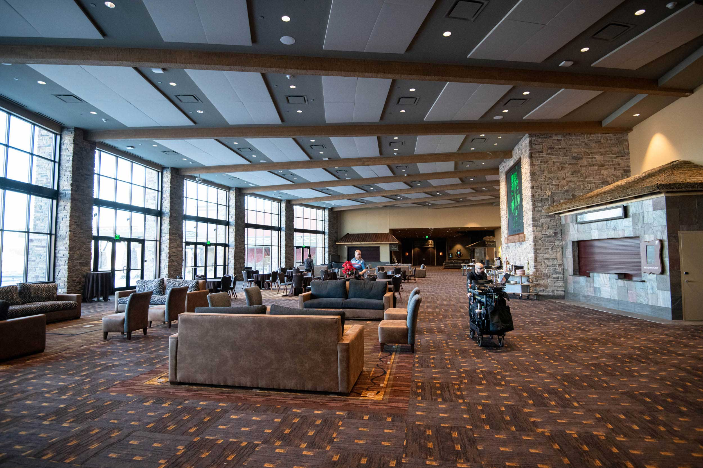

Convention Center
From trade shows and exhibitions to conventions, conferences, retreats, and other gatherings, our dedicated teams will make planning easy and ensure your meeting or event leaves a lasting impression that’s beyond expectations.
205,000 sq. ft. of Flexible Space
33 Meeting Rooms
4 Ballrooms
Giant, Sun-Drenched Pre-Function Spaces
Substantial Registration and Client Office Areas
Enhanced Load-In and Load-Out Capabilities
Complimentary Wi-Fi
Free Parking

Slide 6
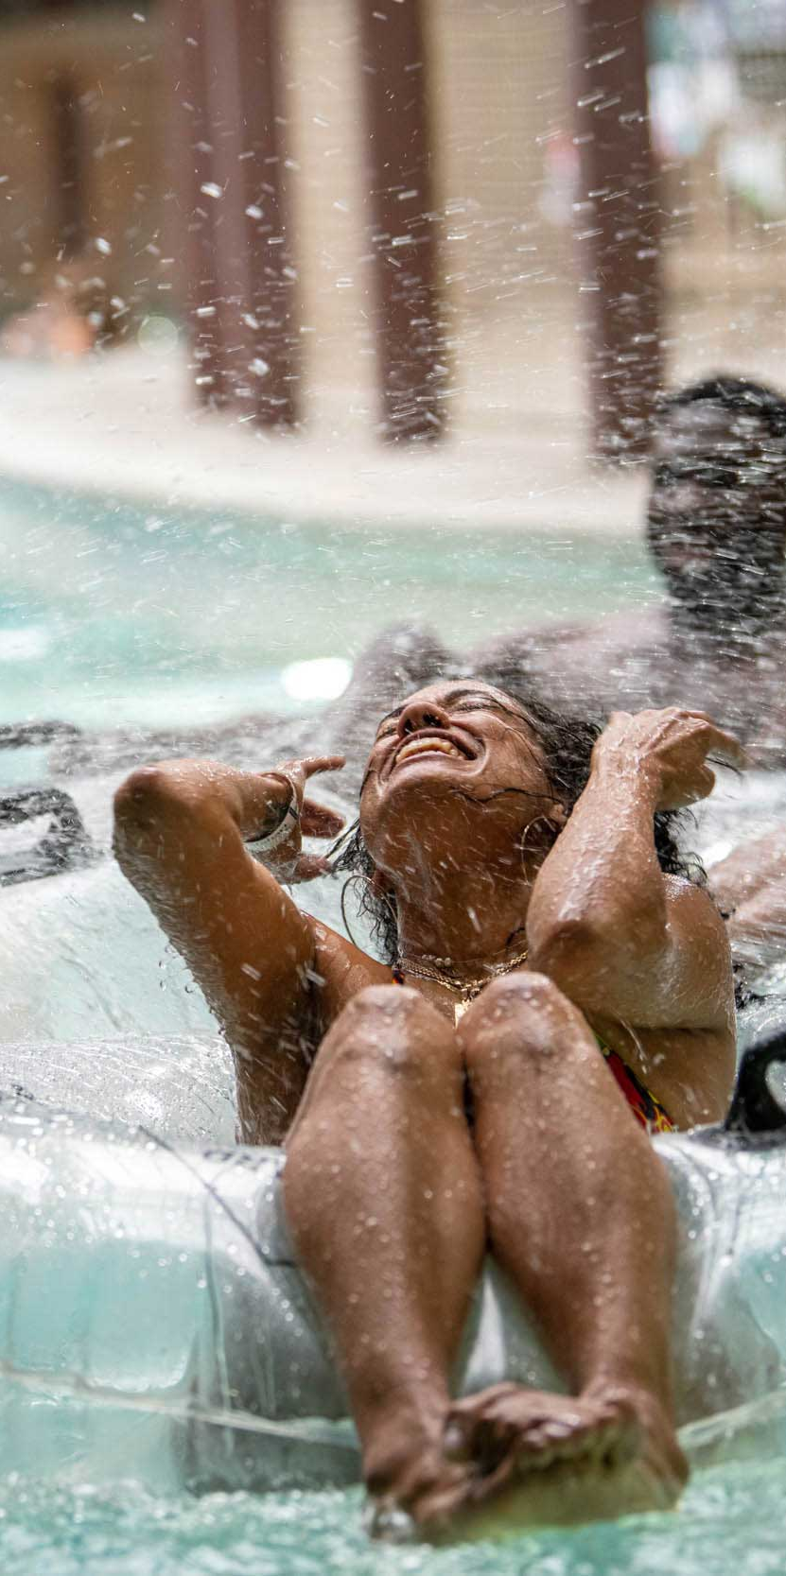
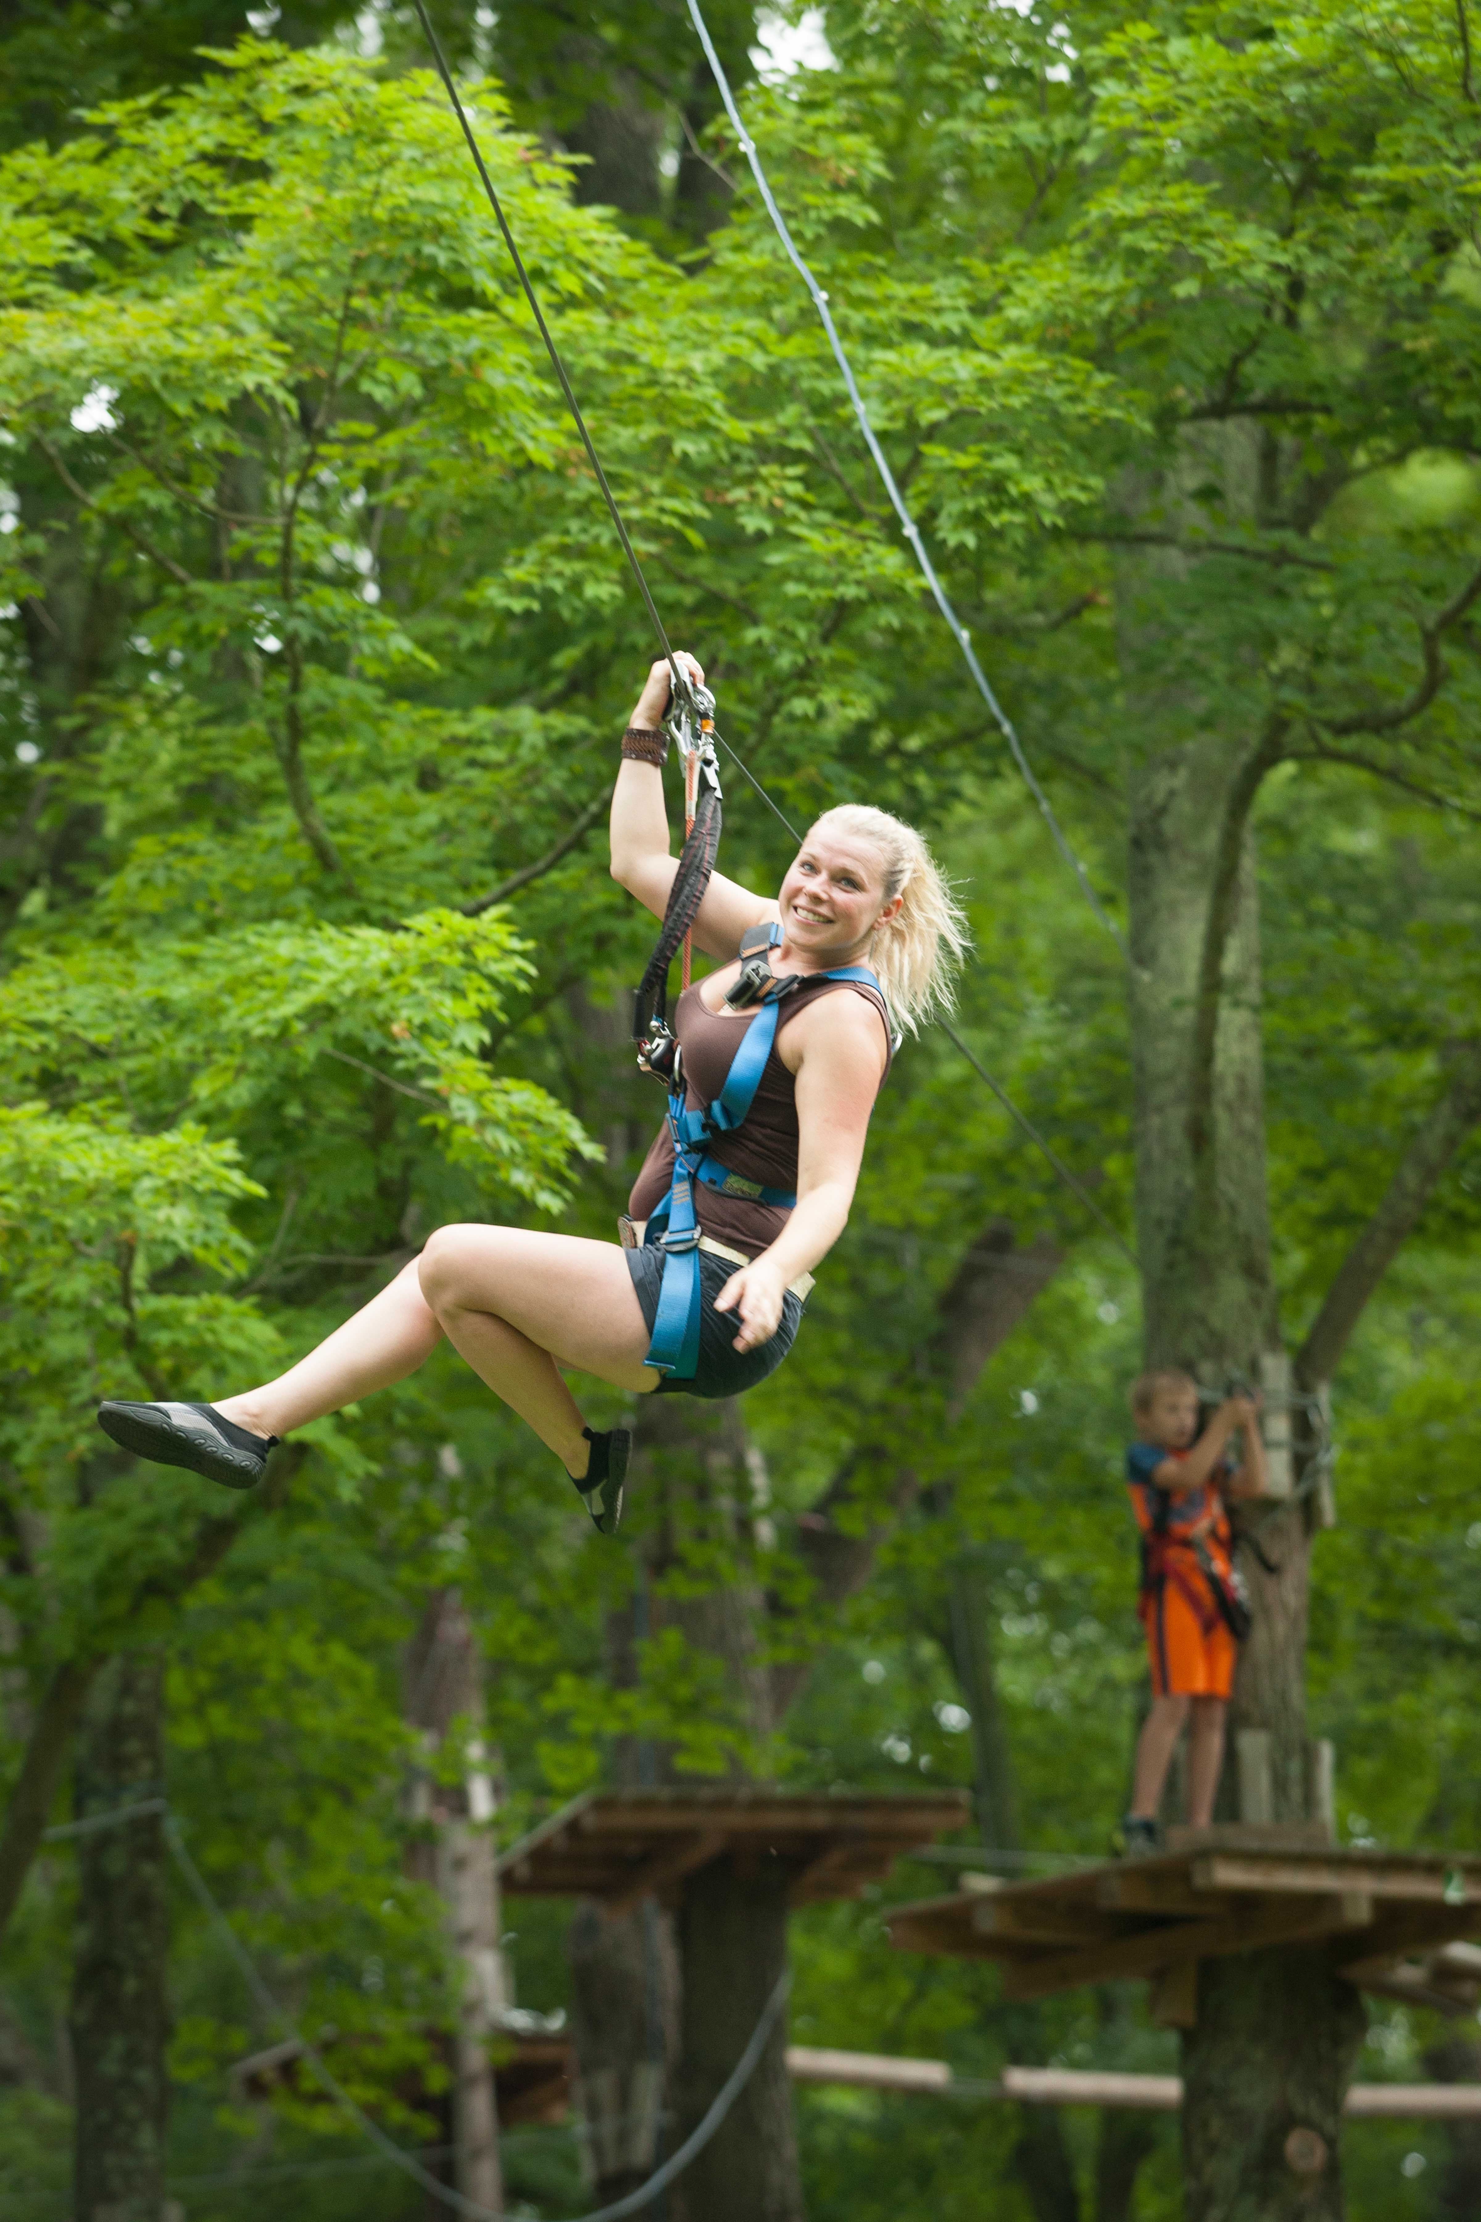
Things To Do
220,000 square-foot Indoor Waterpark
Outdoor Waterpark
Gorilla Grove Treetop Adventures featuring Outdoor Zip Line, Ropes Course, Legends of the Lost Jungle Mini Golf, and Laser Tag
The Big Game Room Arcade
6,000 square feet of Multiple and Varied Retail Shops
Spa Kalahari & Salon

Slide 7

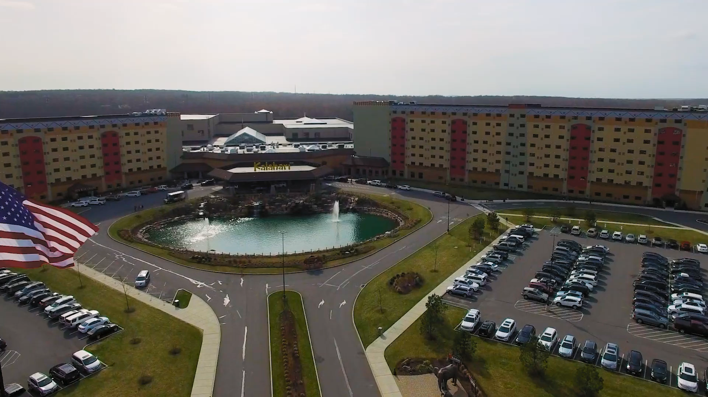
See Why You Should Choose Kalahari
Notes:
Video

Slide 8

Call
855.411.4605
Email
PAGroups@KalahariResorts.com
Website
KalahariMeetings.com
Social
@KalahariMeeting
Visit
250 Kalahari Boulevard, Pocono Manor, PA 18349
Plan Your Event
At The Poconos

