Slide 1

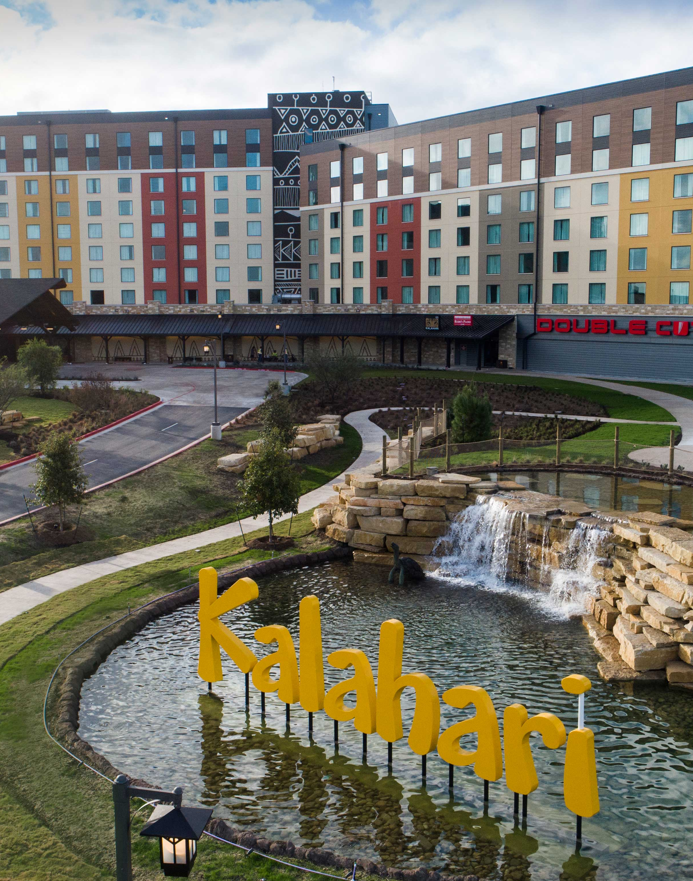
Meetings & Conventions
Kalahari Resorts & Conventions – Round Rock, TX

Slide 2
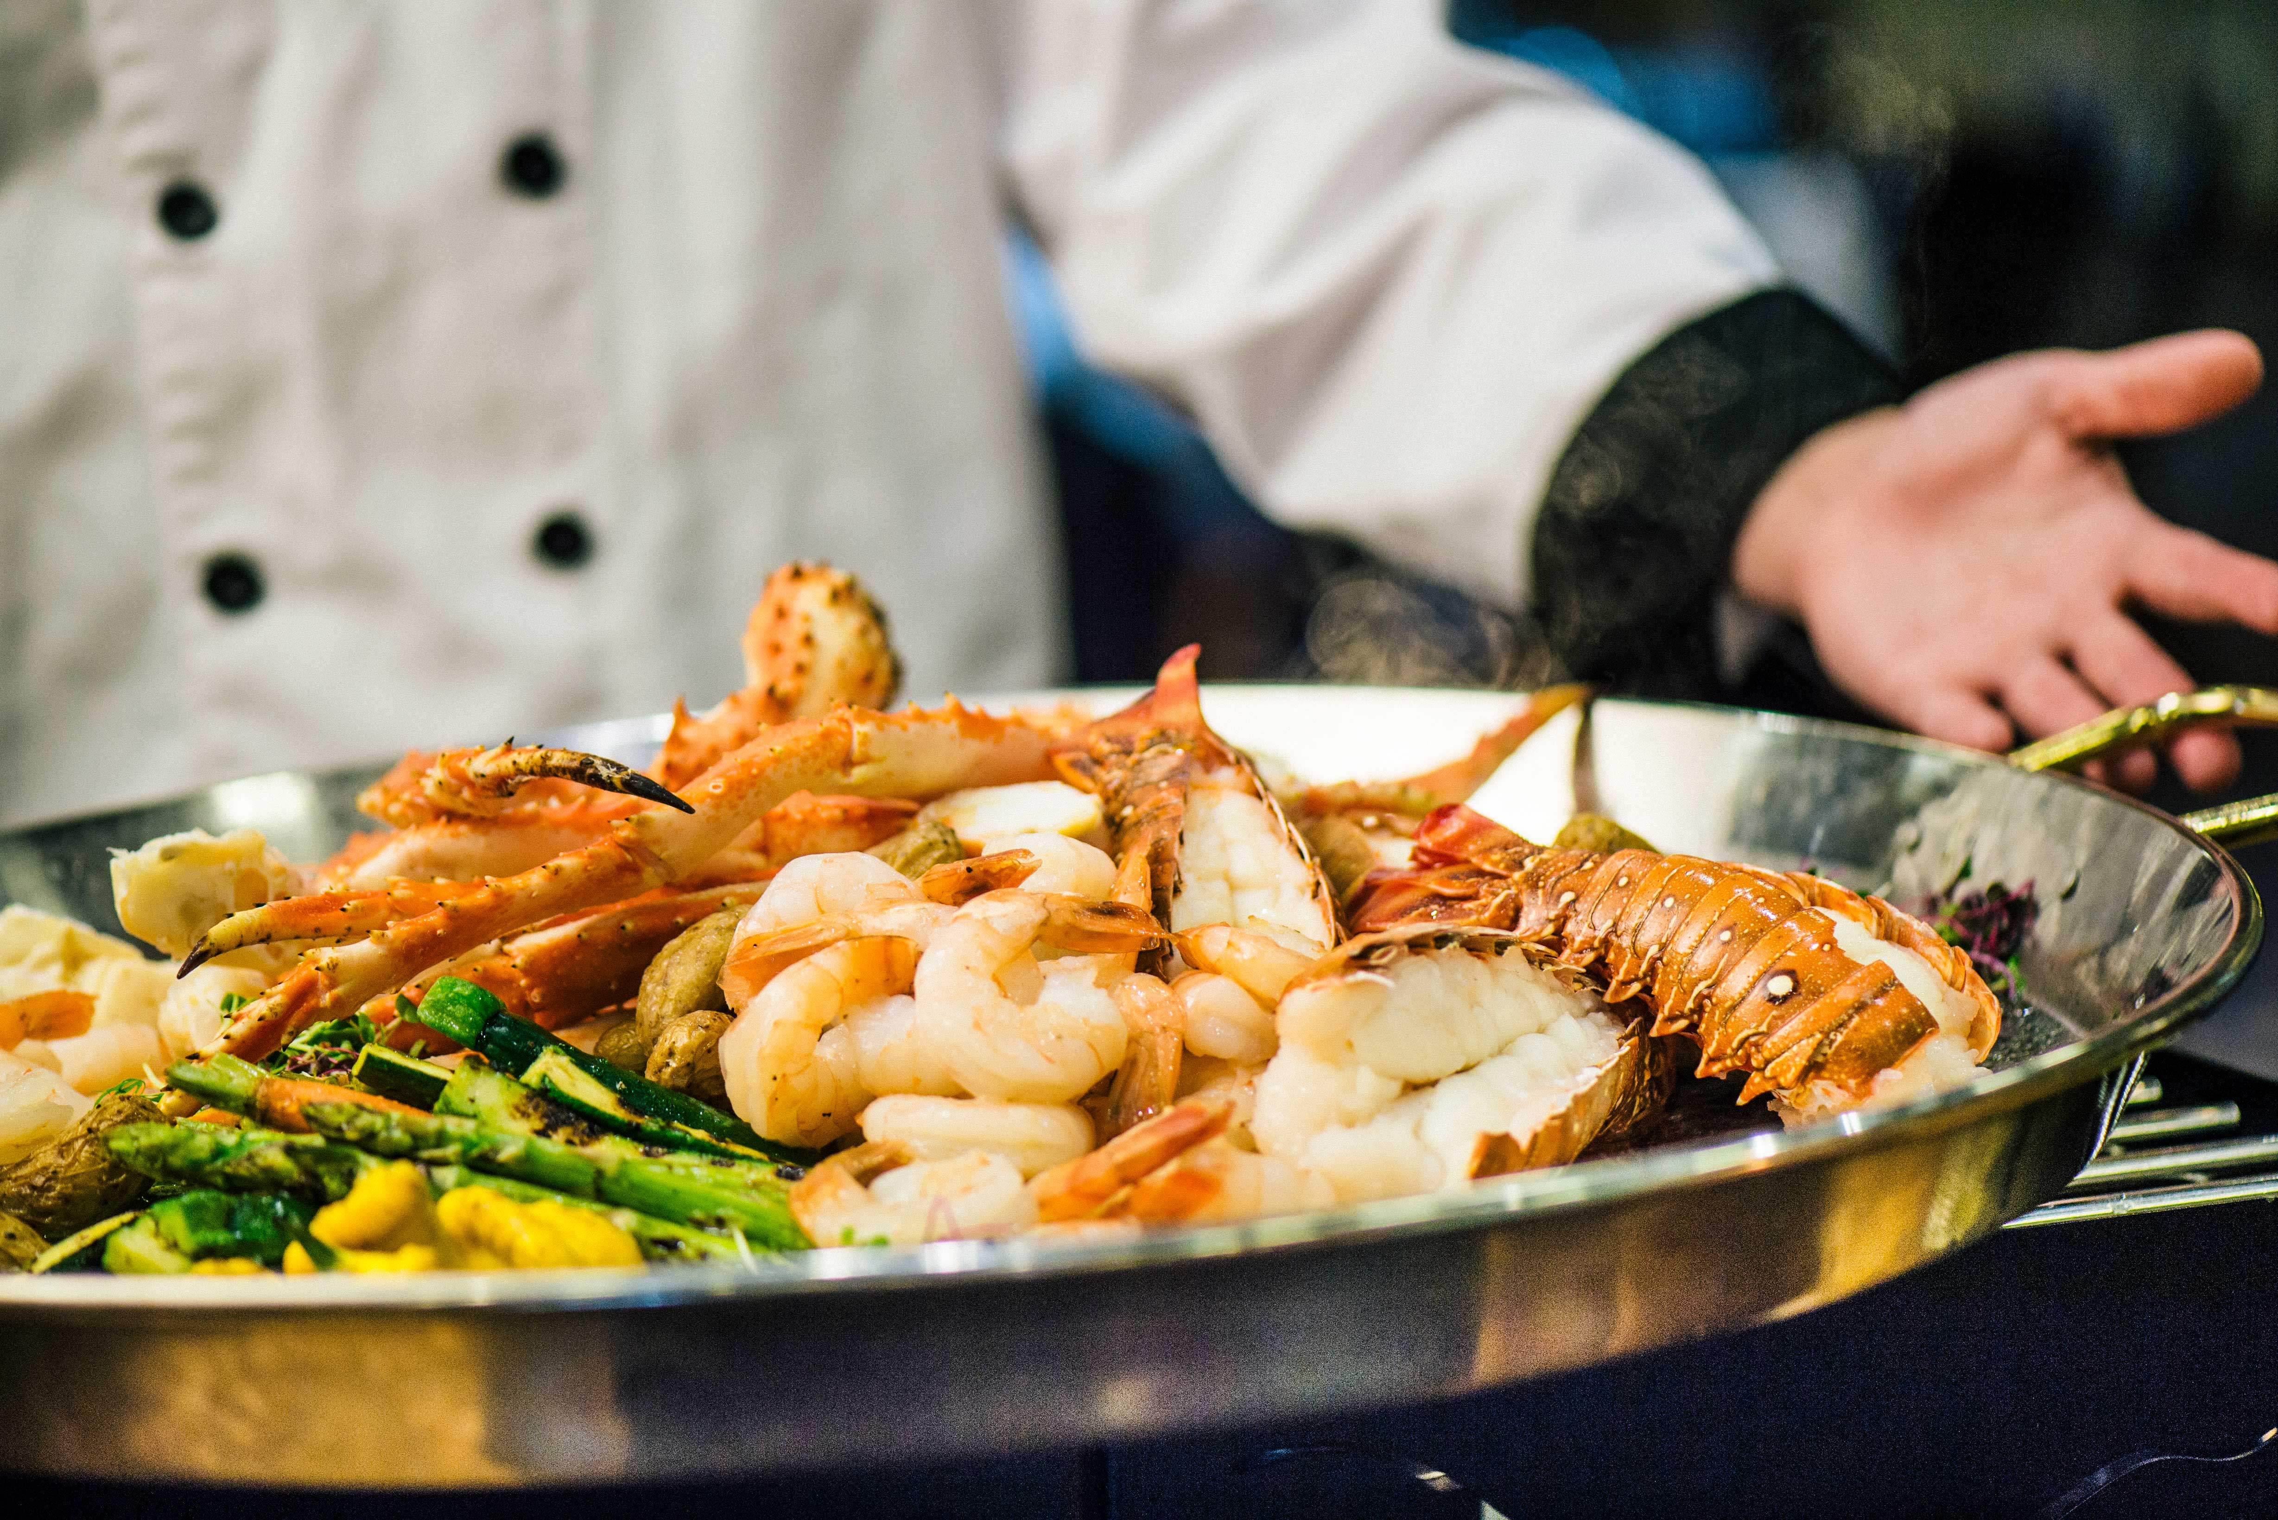
Who We Are
Kalahari Resorts & Conventions is an African-inspired resort and convention center offering a premier all-under-one-roof experience for meetings and events of any size. Inspired by the beauty, culture, and spirit of Africa, our resort is designed to bring people together
for unforgettable getaways and exceptional events.
Our Features
Guest Rooms
Premium Dining
Customizable Meeting Spaces
America’s Largest & Best in Family-Friendly Amenities

Slide 3
Guest Rooms
975 Guest Rooms & Suites
1-to-3 Bedroom Suites
Including Presidential Suites
Whether you're traveling alone or with a group of 44 (yup, 44!), we've got you covered.
All rooms include a microwave, coffee maker, refrigerator, iron, ironing board, in-room safe, complimentary Wi-Fi, remote control television with cable, alarm clock, voicemail system, hair dryer, and luxurious bath amenities.

Slide 4
Hundreds of Flavors
All-Under-One-Roof
We've got something to satisfy every taste, from steak houses to ice cream shops. You'll never have to eat in the same spot twice, but you just might want to.
Double Cut Steak House
Sortino’s Italian Kitchen
Received 2025 OpenTable Diners’ Choice Award
Redd’s Piano Bar & Lounge
Great Karoo Marketplace Buffet
MACS Macaroni and Cheese Shop
B-LUX Grill & Bar
Cinco Niños
Received 2025 OpenTable Diners’ Choice Award

Slide 5
Convention Center
From trade shows and exhibitions to conventions, conferences, retreats, and other gatherings, our dedicated teams will make planning easy and ensure your meeting or event leaves a lasting impression that’s beyond expectations.
200,000 sq. ft. of Flexible Space
16 Meeting Rooms
2 Ballrooms
50,000 square feet of Outdoor Event Space
Substantial Registration and Client Office Areas
Enhanced Load-In and Load-Out Capabilities
Complimentary Wi-Fi
Free Parking

Slide 6
Things To Do
223,000 square-foot Indoor Waterpark
215,000 square-foot Outdoor Waterpark
Tom Foolerys Adventure Park featuring thrill rides, a ropes course, climbing walls, an indoor zip line, bowling, laser tag, 250+ arcade games, and more
Over 10,000 square feet of
Multiple and Varied Retail Shops
Spa Kalahari & Salon

Slide 7

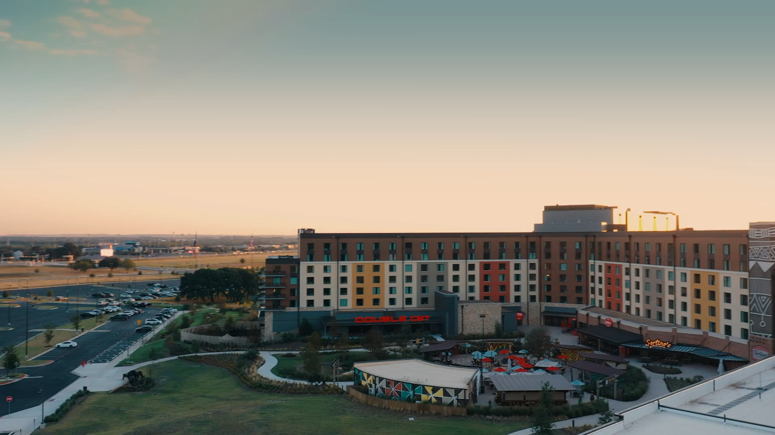
See Why You Should Choose Kalahari
Notes:
Video

Slide 8

Call
855.411.4605
Email
TXGroups@KalahariResorts.com
Website
KalahariMeetings.com
Social
@KalahariMeeting
Visit
3001 Kalahari Boulevard, Round Rock, TX 78665
Plan Your Event
At Round Rock

