Slide 1

Meetings & Conventions
Kalahari Resorts & Conventions

Slide 2
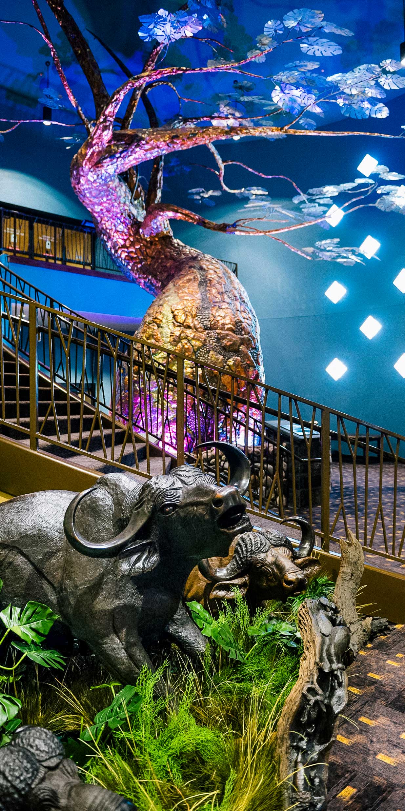
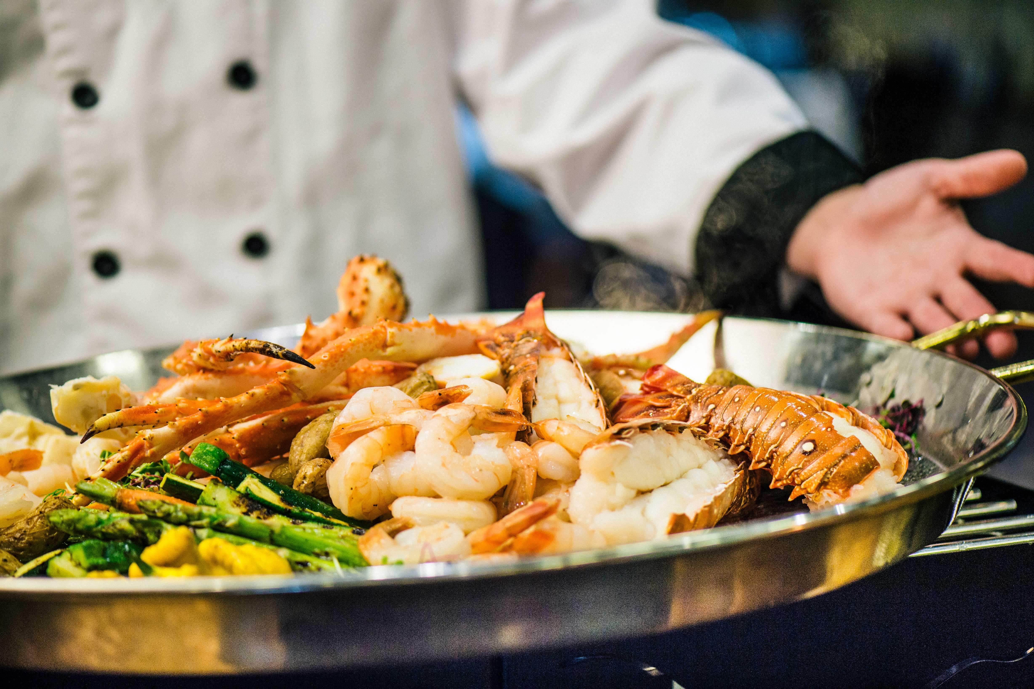
Who We Are
Kalahari Resorts & Conventions is an African-themed resort and convention center offering premier destinations in Wisconsin, Ohio, Pennsylvania, Texas, and Virginia (coming 2026) for meetings and events of any size.
Inspired by the beauty, culture, and spirit of Africa, our resorts are designed to bring people together for unforgettable getaways and exceptional events.
Our Features
Guest Rooms
Premium Dining
Customizable Meeting Spaces
America’s Largest & Best in Family-Friendly Amenities

Slide 3
Guest Rooms
Whether you're traveling alone or with a group of 44 (yup, 44!), we've got you covered.
The adventure doesn’t end after your conference. Every suite at Kalahari Resorts & Conventions is decorated with imported art and artifacts, designed to inspire your imagination.
All rooms include a microwave, coffee maker, refrigerator, iron, ironing board, in-room safe, complimentary Wi-Fi, remote control television with cable, alarm clock, voicemail system, hair dryer, and luxurious bath amenities.

Slide 4
Hundreds of Flavors All-Under-One-Roof
At Kalahari Resorts & Conventions, we know that delicious food is an important component to any successful meeting or event. Whether planning for a buffet lunch or a formal dinner, you can count on our team for an incredible dining experience.
Our resorts have something to satisfy every taste, from steak houses to ice cream shops. You’ll never have to eat in the same spot twice, but you just might want to.

Slide 5
Convention Center
From trade shows and exhibitions to conventions, conferences, retreats, and other gatherings, our dedicated teams will make planning easy and ensure your meeting or event leaves a lasting impression that’s beyond expectations.

Slide 6
Things To Do
Mix business with pleasure. When the work is done, it’s time for play. Why not extend your meeting trip and turn it into a much-needed vacation? We have everything to ensure a pleasurable stay for you and your family if they are lucky enough to tag along.
Always Included With Your Stay
Waterpark Admission
Free Wifi
Fitness Center Access

Slide 7
Wisconsin Dells, WI
1,035 Guest Rooms
212,000 Square Feet of Meeting Space
3 Ballrooms
47 Meeting Rooms
4 Boardrooms
Award Winning Dining
Double Cut Steak House, Cinco Niños, Redd’s Piano Bar & Lounge, Sortino’s Italian Kitchen, and Wisconsin Brew Pub
On-Site Attractions
Indoor & Outdoor Waterpark
Tom Foolerys Adventure Park
Spa Kalahari & Salon

Slide 8
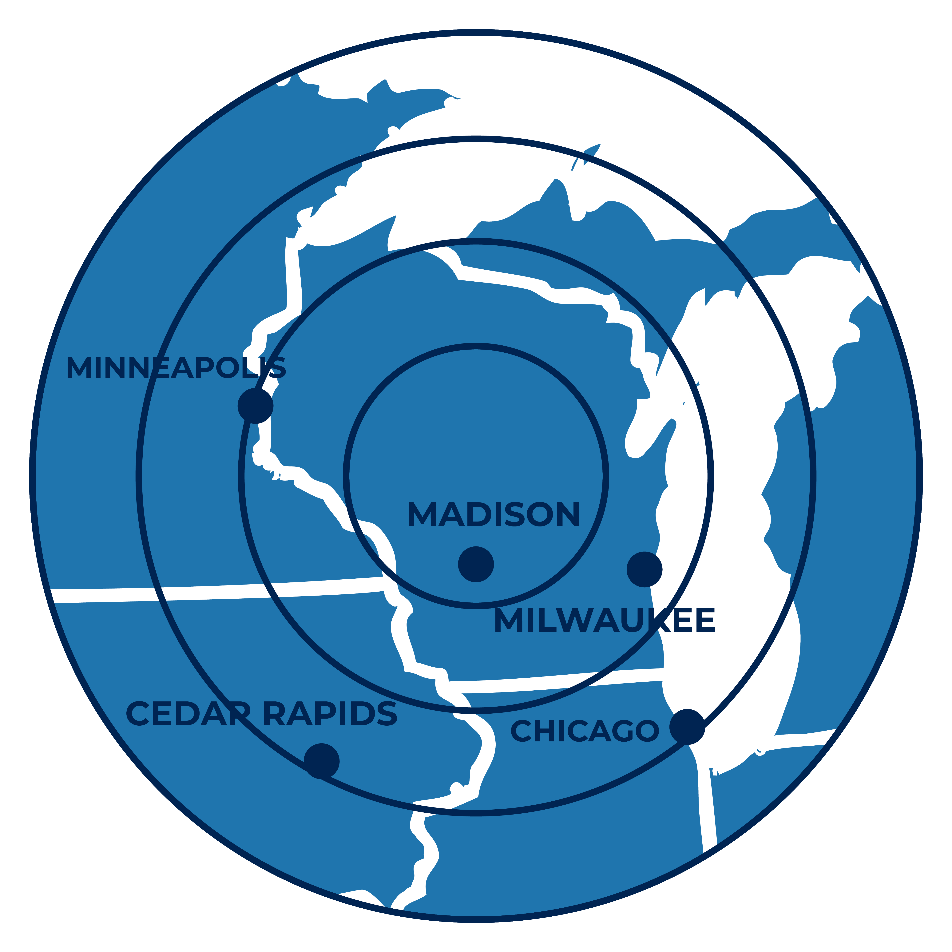
Where We Are Located
Wisconsin Dells, WI
Madison, WI: 45 minutes, 50 miles
Milwaukee, WI: 1.75 hours, 118 miles
Chicago, IL: 3 hours, 190 miles
Cedar Rapids, IA: 3 hours, 182 miles
Minneapolis, MN: 3.25 hours, 221 miles
Dane County Regional (MSN): 45 miles
General Mitchell Intl (MKE): 123 miles
Chicago O’Hare (ORD): 176 miles

Slide 9
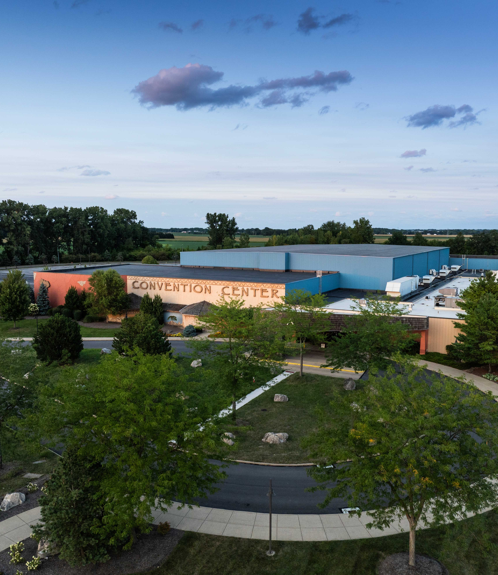
Sandusky, OH
890 Guest Rooms
215,000 Square Feet of Meeting Space
3 Ballrooms
39 Meeting Rooms
2 Boardrooms
Award Winning Dining
Sortino’s Italian Kitchen, B-LUX Grill & Bar, Cinco Niños, and MACS Macaroni and Cheese Shop,
On-Site Attractions
Indoor & Outdoor Waterpark
Big Game Room Arcade
Safari Outdoor Adventure Park
Spa Kalahari & Salon

Slide 10
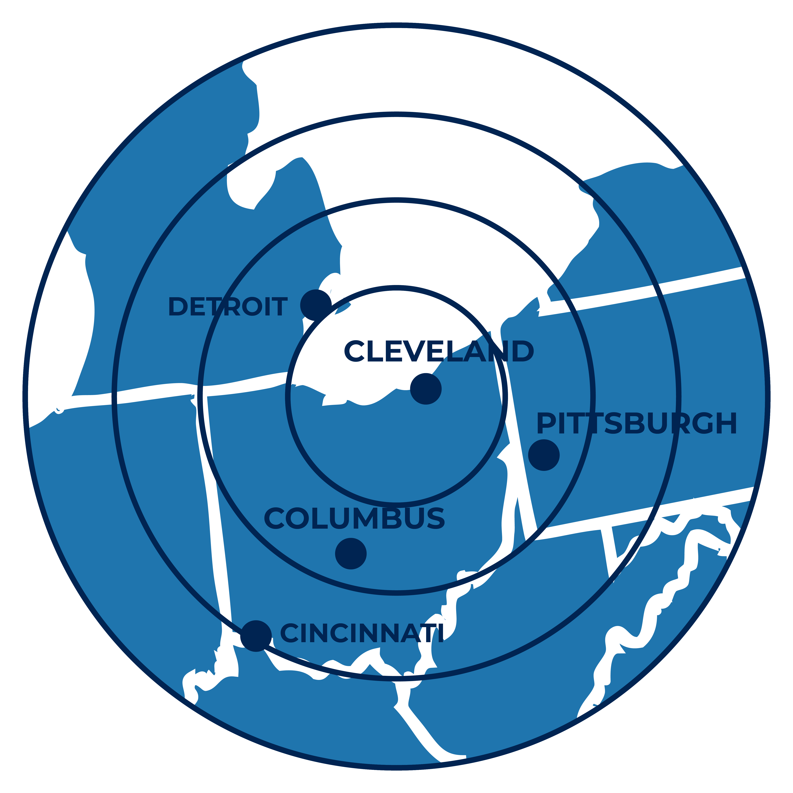
Where We Are Located
Sandusky, OH
Cleveland, OH: 1 hour, 60 miles
Columbus, OH: 2 hours, 113 miles
Detroit, MI: 2 hours, 116 miles
Pittsburgh, PA: 2.75 hours, 176 miles
Cincinnati, OH: 3.5 hours, 220 miles
Cleveland (CLE): 45 miles
Detroit (DTW): 62 miles
Akron (CAK): 75 miles
Columbus (CMH): 100 miles

Slide 11
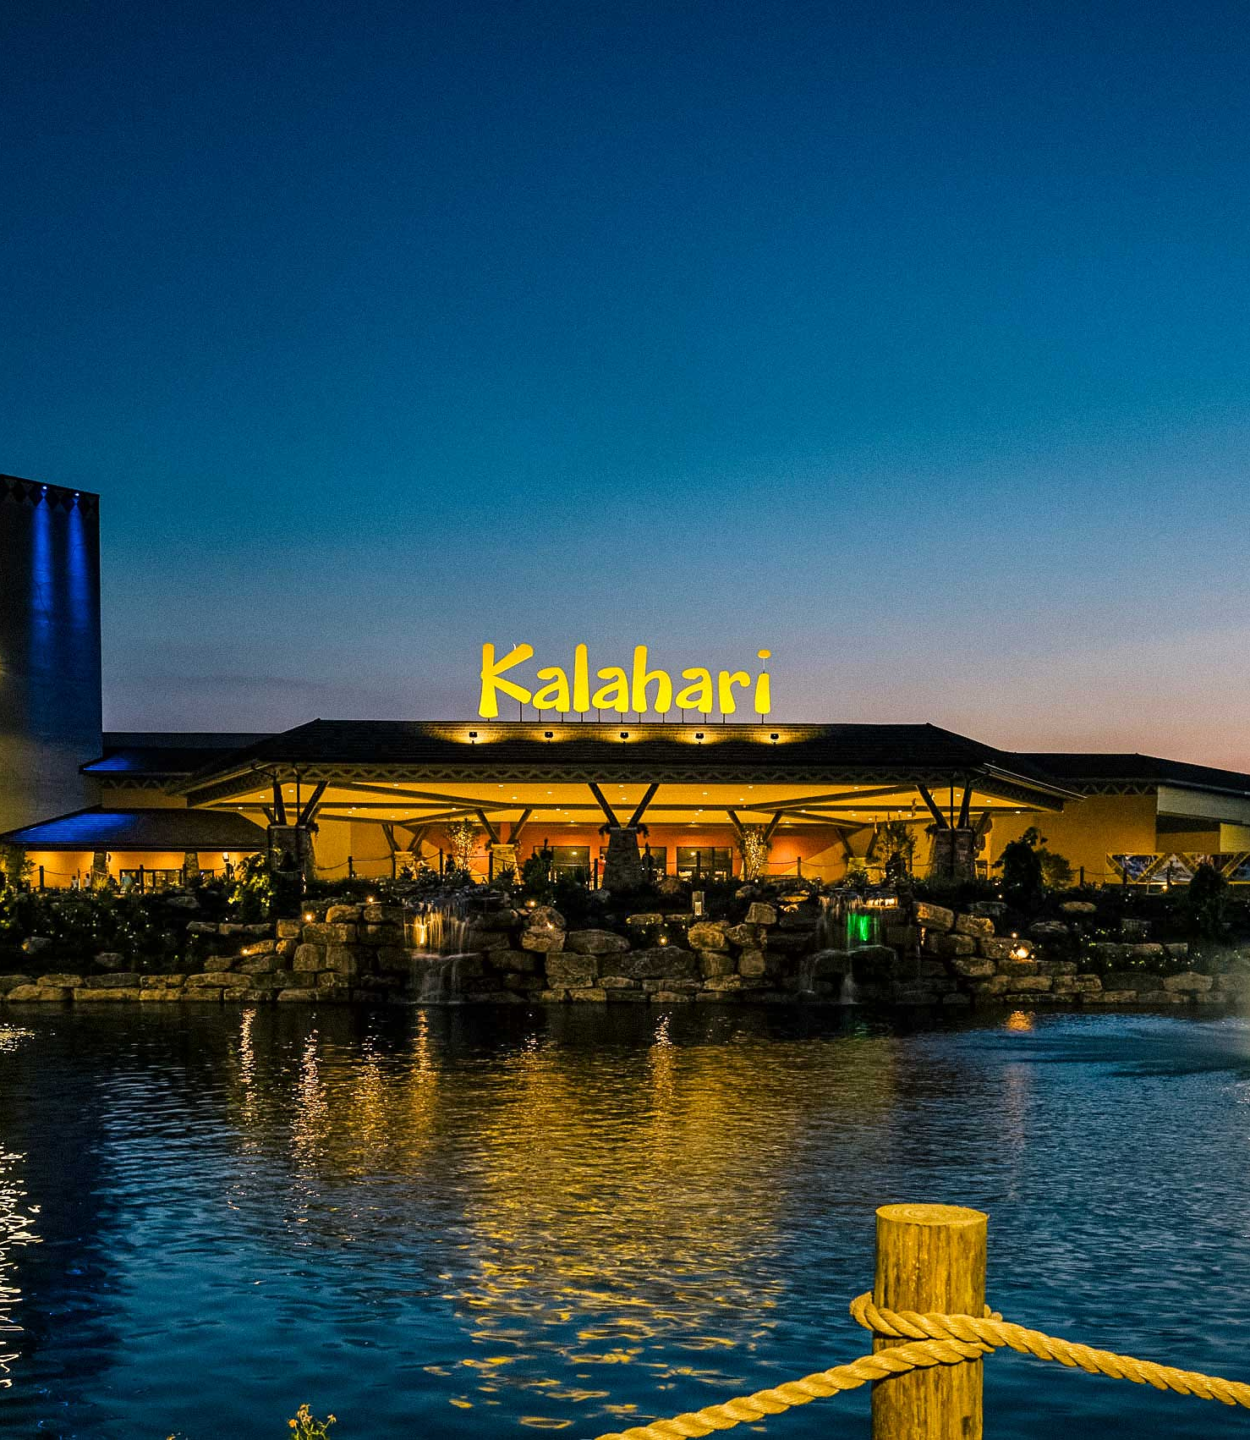
Pocono Mountains, PA
977 Guest Rooms
205,000 Square Feet of Meeting Space
3 Ballrooms
33 Meeting Rooms
2 Boardrooms
Award Winning Dining
Double Cut Steak House, B-LUX Grill & Bar, Cinco Niños, Great Karoo Marketplace Buffet, MACS Macaroni and Cheese Shop, Redd’s Piano Bar & Lounge, and Sortino’s Italian Kitchen
On-Site Attractions
Indoor & Outdoor Waterpark
Big Game Room Arcade
Gorilla Grove Treetop Adventures
Spa Kalahari & Salon

Slide 12
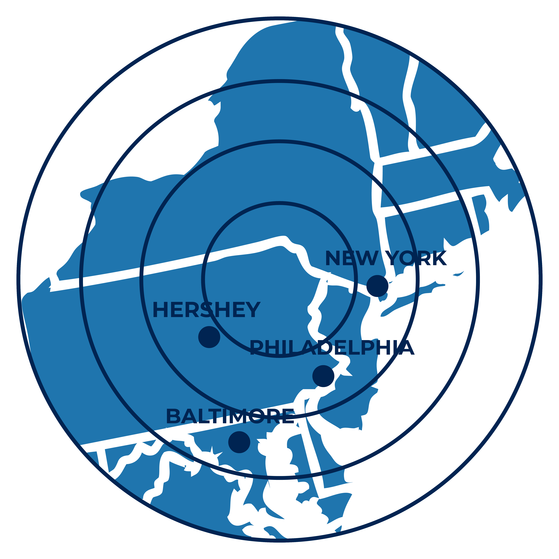
Where We Are Located
Pocono Mountains, PA
Hershey, PA: 1.75 hours, 117 miles
Philadelphia, PA: 1.75 hours, 109 miles
New York, NY: 1.5 hours, 91 miles
Baltimore, MD: 3 hours, 220 miles
Lehigh Valley International (ABE): 30 miles
Wilkes Barre/Scranton Intl (AVP): 37 miles
Newark Liberty Intl. (EWR): 88 miles

Slide 13
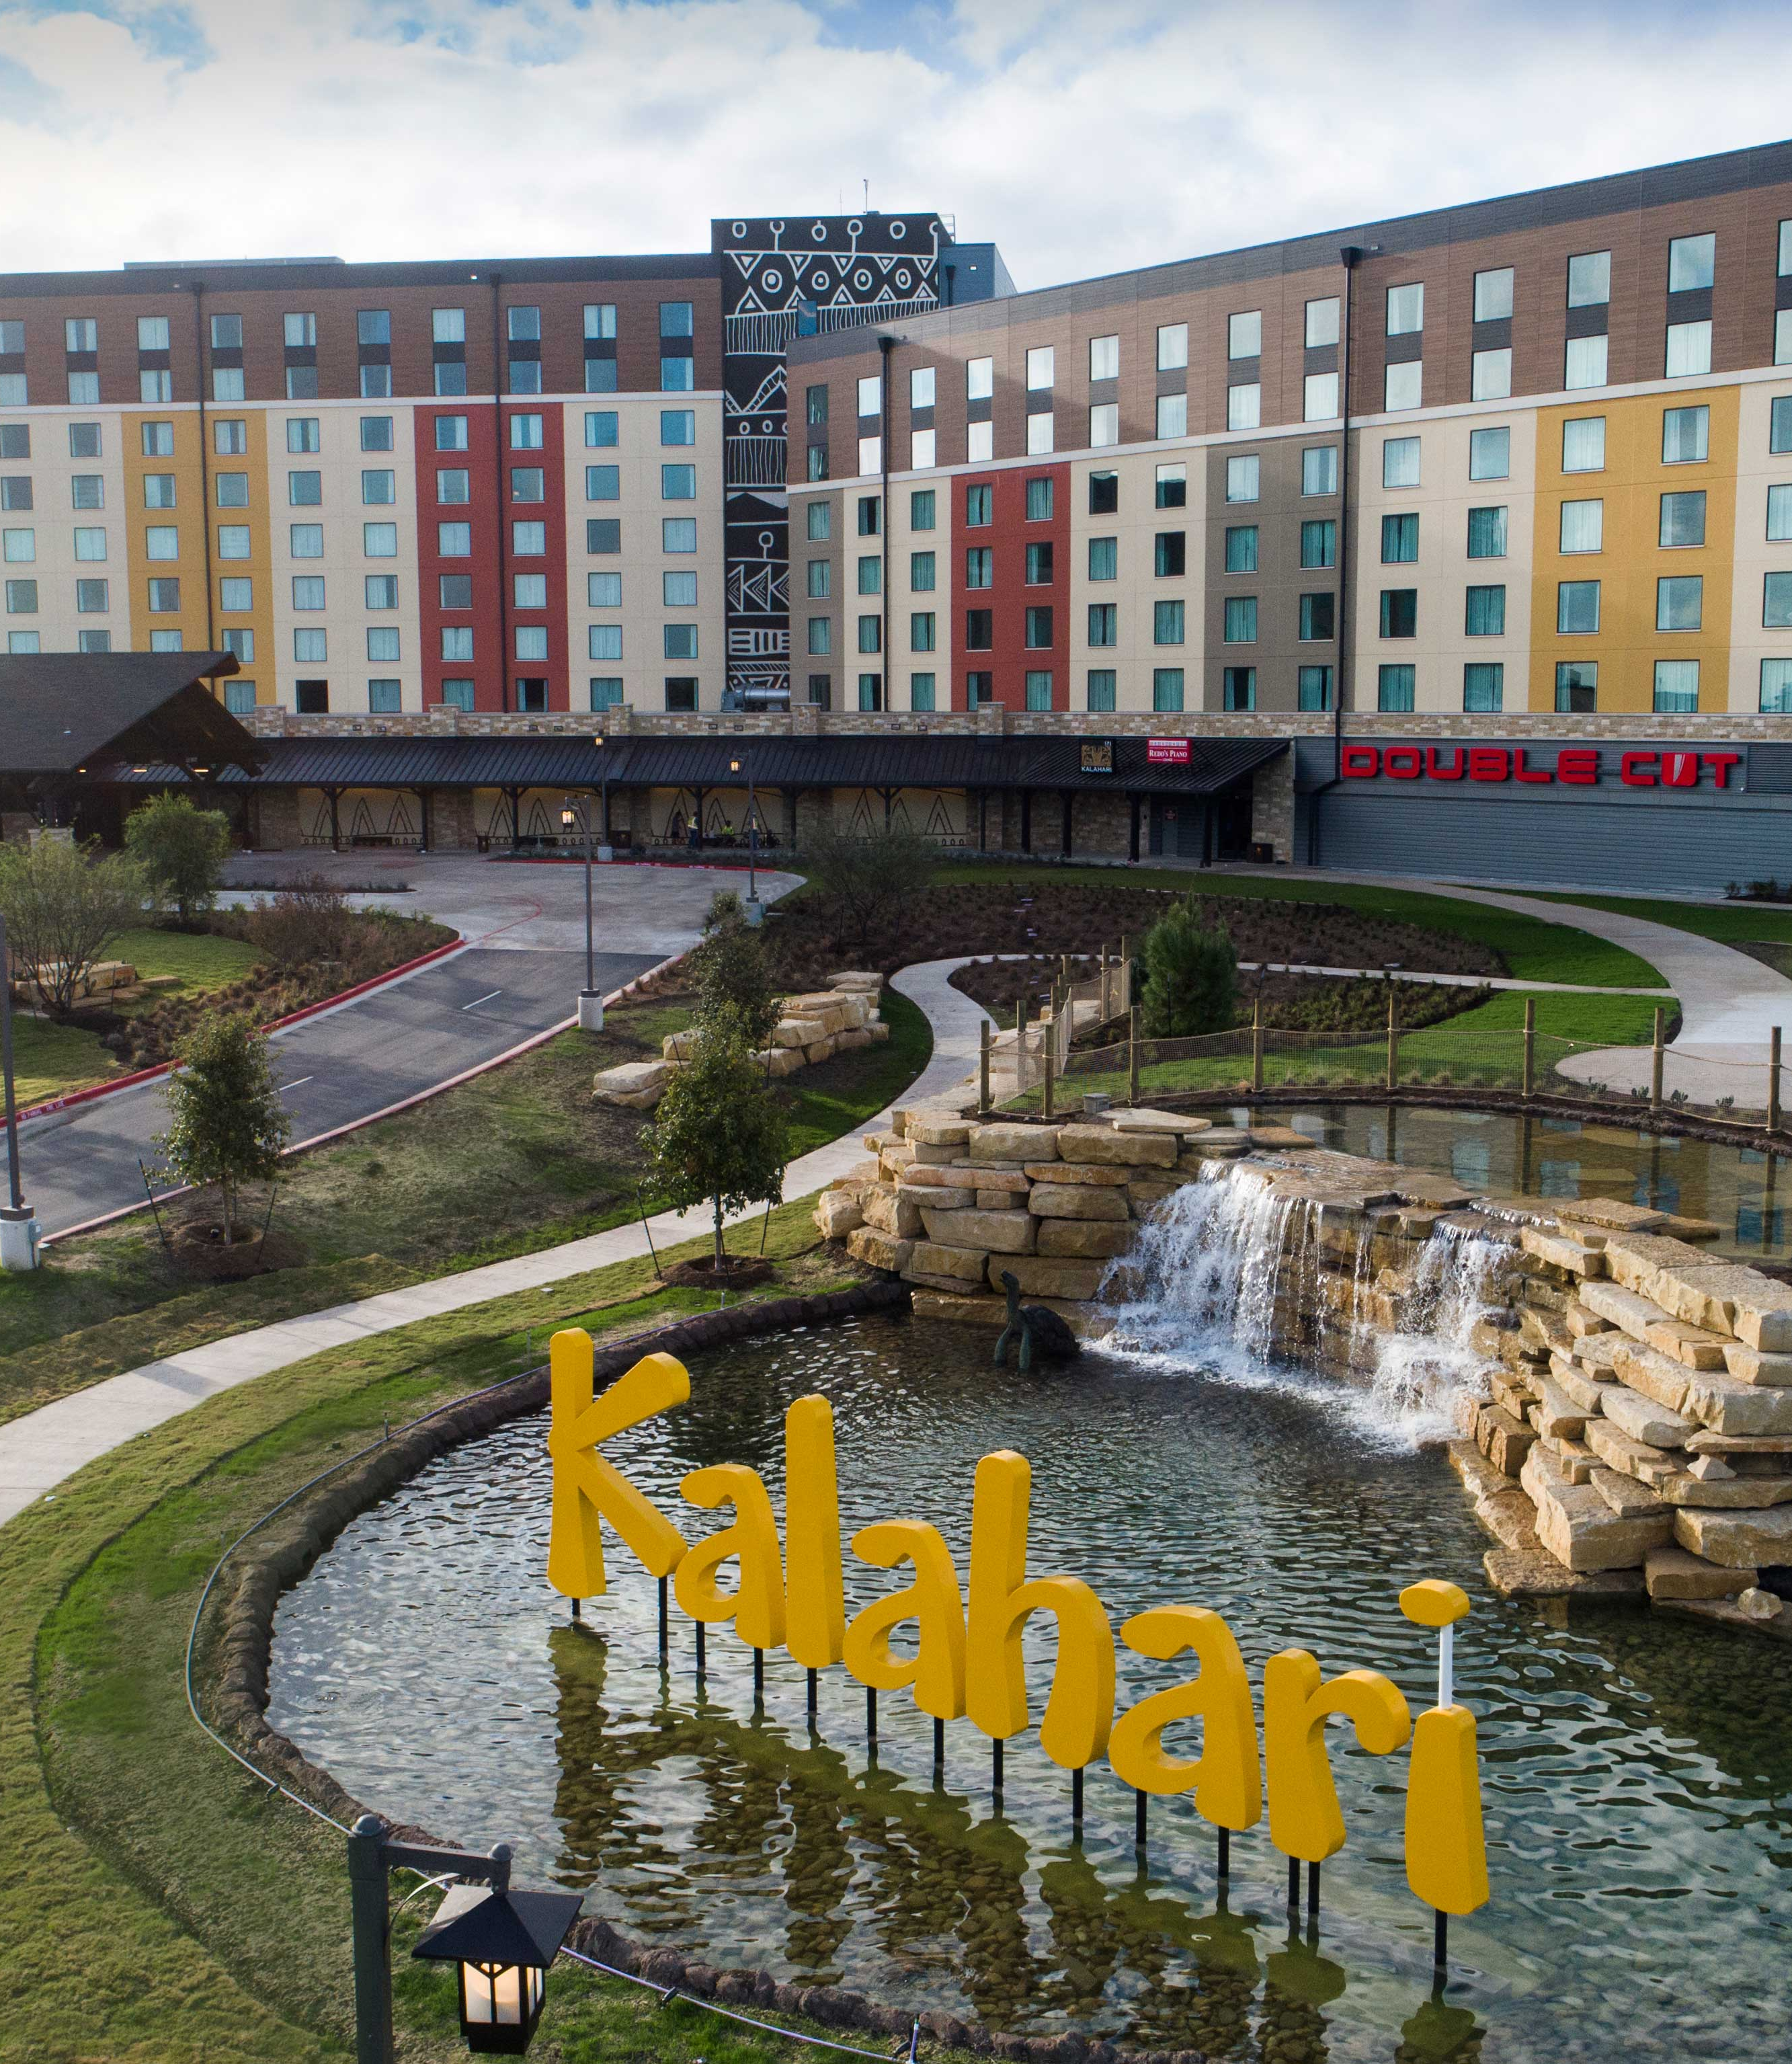
Round Rock, TX
975 Guest Rooms
200,000 Square Feet of Meeting Space
2 Ballrooms
16 Meeting Rooms
Award Winning Dining
Double Cut Steak House, B-LUX Grill & Bar, Cinco Niños, Great Karoo Marketplace Buffet, MACS Macaroni and Cheese Shop, Redd’s Piano Bar & Lounge, and Sortino’s Italian Kitchen
On-Site Attractions
Indoor & Outdoor Waterpark
Tom Foolerys Adventure Park
Spa Kalahari & Salon

Slide 14
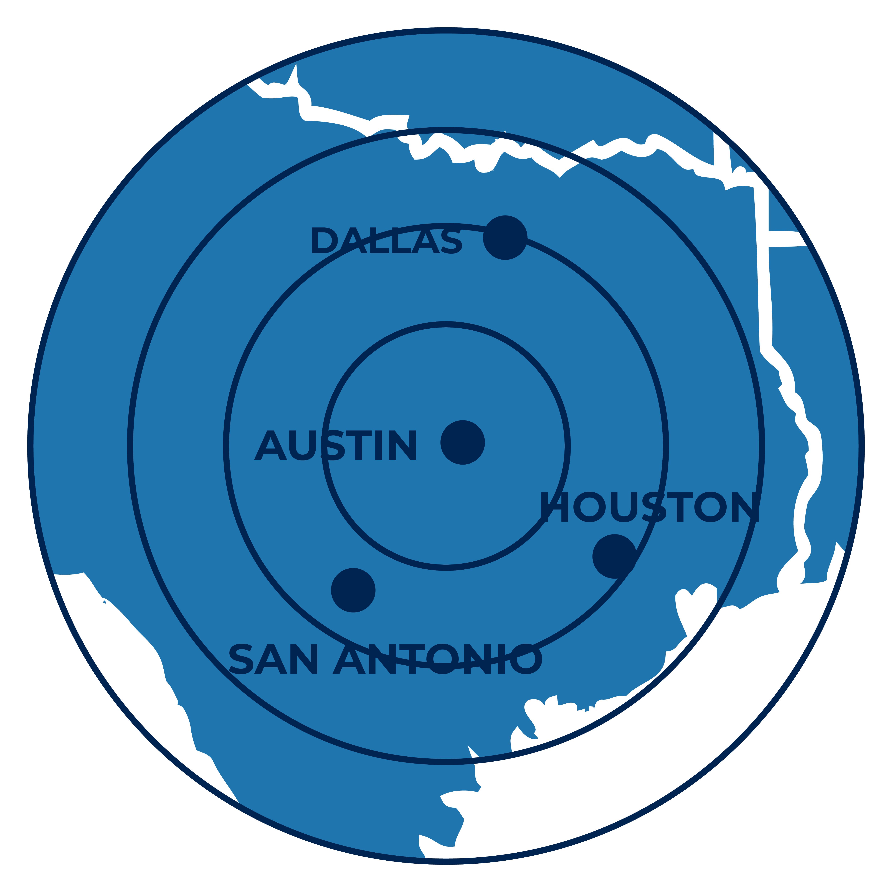
Where We Are Located
Round Rock, TX
Austin, TX: 30 minutes, 23 miles
San Antonio, TX: 1.75 hours, 114 miles
Houston, TX: 2.75 hours, 168 miles
Dallas, TX: 2.5 hours, 179 miles
Austin-Bergstrom Intl (AUS): 32 miles

Slide 15
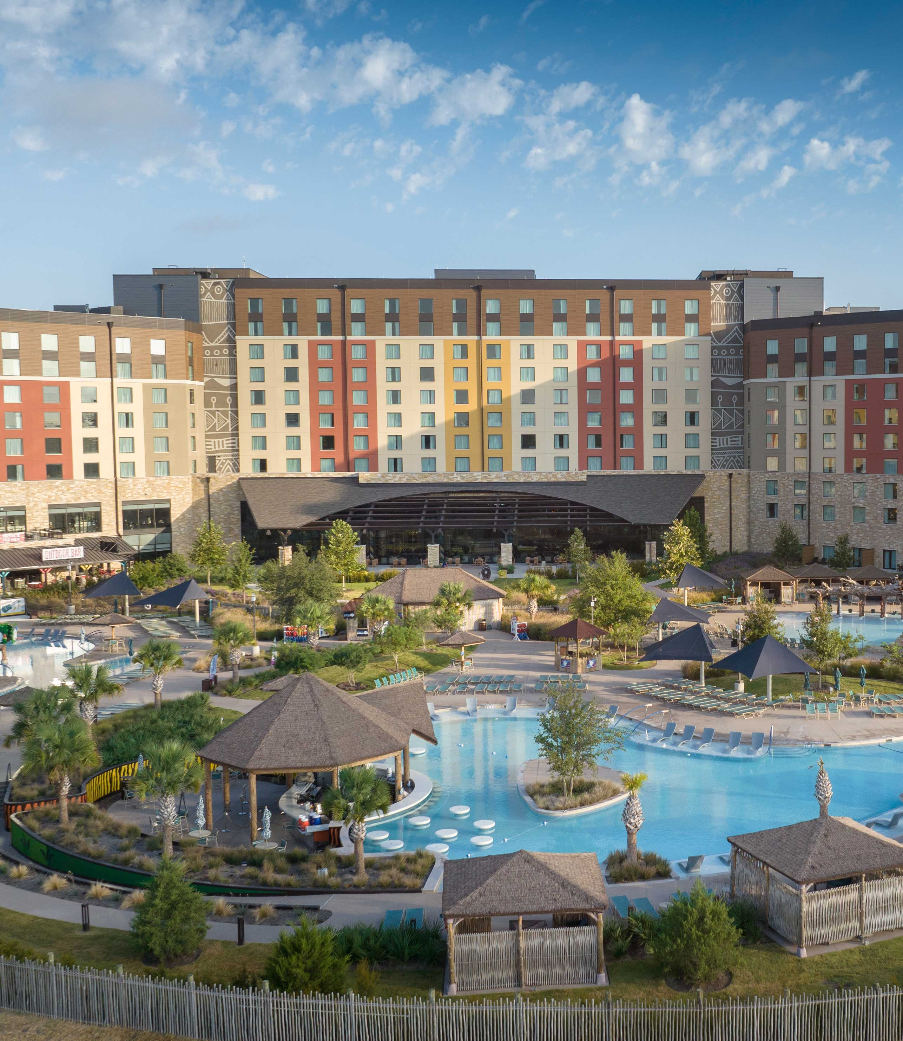
Spotsylvania, VA Coming 2026
907 Guest Rooms
150,000 Square Feet of Meeting Space
2 Ballrooms
16 Meeting Rooms
Award Winning Dining
Double Cut Steak House, Cinco Niños, Redd’s Piano Bar & Lounge, Sortino’s Italian Kitchen, and B-LUX Grill & Bar
On-Site Attractions
Indoor & Outdoor Waterpark
Tom Foolerys Adventure Park

Slide 16
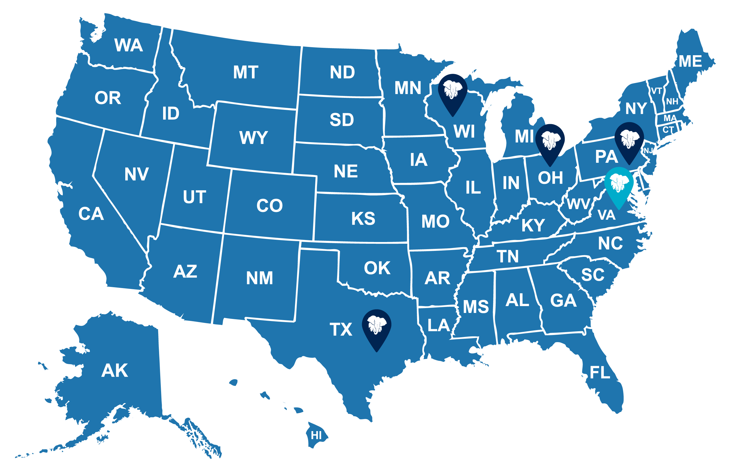
Our Resorts
Open
Coming Soon

Slide 17


See Why You Should Choose Kalahari
Notes:
Video

Slide 18

Plan Your Event At Kalahari
Call
855.411.4605
Website
KalahariMeetings.com
Social
@KalahariMeeting

