Slide 2
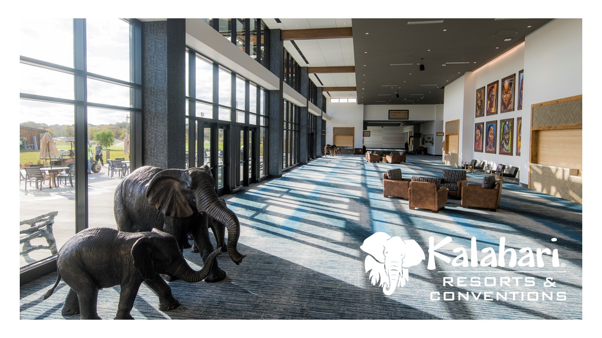

Slide 17
KALAHARI RESORTS & CONVENTIONS
WISCONSIN DELLS, WI
Radius Markers
60 Miles
120 Miles
180 Miles
240 Miles

Slide 18
KALAHARI RESORTS & CONVENTIONS
SANDUSKY, OH
Radius Markers
60 Miles
120 Miles
180 Miles
240 Miles

Slide 19
KALAHARI RESORTS & CONVENTIONS
POCONO MOUNTAINS, PA
Radius Markers
60 Miles
120 Miles
180 Miles
240 Miles

Slide 20
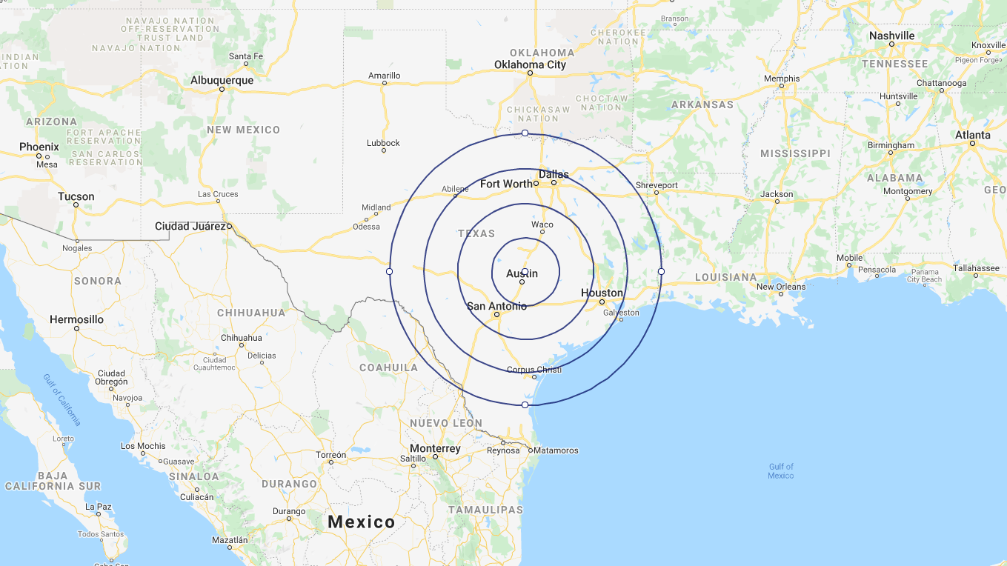
KALAHARI RESORTS & CONVENTIONS
ROUND ROCK, TX
Radius Markers
60 Miles
120 Miles
180 Miles
240 Miles

Slide 21
