Slide 1

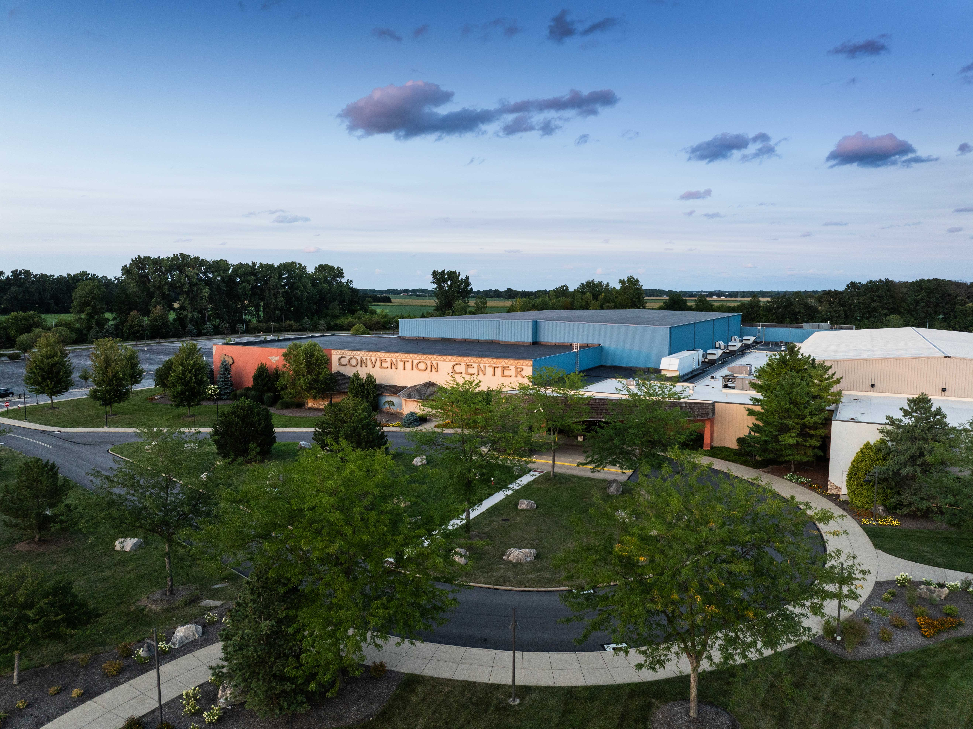
Meetings & Conventions
Kalahari Resorts & Conventions – Sandusky, Ohio

Slide 2
Who We Are
Kalahari Resorts & Conventions is an African-inspired resort and convention center offering a premier all-under-one-roof experience for meetings and events of any size. Inspired by the beauty, culture, and spirit of Africa, our resort is designed to bring people together
for unforgettable getaways and exceptional events.
Our Features
Guest Rooms
Premium Dining
Customizable Meeting Spaces
America’s Largest & Best in Family-Friendly Amenities

Slide 3
Guest Rooms
890 Guest Rooms & Suites
1-to-5 Bedroom Suites
Including Presidential Suites
Whether you're traveling alone or with a group of 44 (yup, 44!), we've got you covered.
All rooms include a microwave, coffee maker, refrigerator, iron, ironing board, in-room safe, complimentary Wi-Fi, remote control television with cable, alarm clock, voicemail system, hair dryer, and luxurious bath amenities.

Slide 4

Hundreds of Flavors
All-Under-One-Roof
We've got something to satisfy every taste, from Italian cuisine to macaroni and cheese shops. You'll never have to eat in the same spot twice, but you just might want to.
Sortino’s Italian Kitchen
Received 2025 OpenTable Diners’ Choice Award
B-LUX Grill & Bar
Cinco Niños
MACS Macaroni and Cheese Shop

Slide 5
Convention Center
From trade shows and exhibitions to conventions, conferences, retreats, and other gatherings, our dedicated teams will make planning easy and ensure your meeting or event leaves a lasting impression that’s beyond expectations.
215,000 sq. ft. of Flexible Space
39 Meeting Rooms
3 Ballrooms
Over 30,000 square feet of Pre-Function Spaces
Substantial Registration and Client Office Areas
Enhanced Load-In and Load-Out Capabilities
Complimentary Wi-Fi
Free Parking

Slide 6
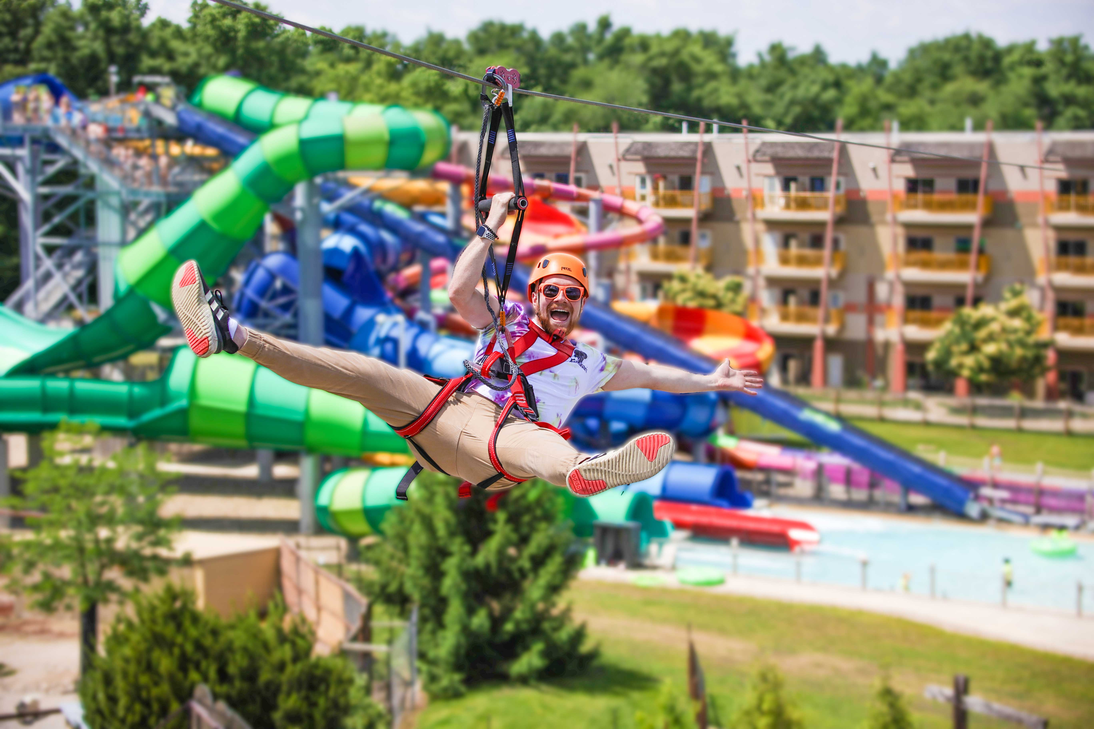
Things To Do
173,000 square-foot Indoor Waterpark
77,000 square-foot Outdoor Waterpark
Safari Outdoor Adventure Park featuring zip lining, rope adventures, climbing walls, a 50-foot free fall jump tower, and an animal park
The Big Game Room Arcade
Multiple and Varied Retail Shops
Spa Kalahari & Salon

Slide 7

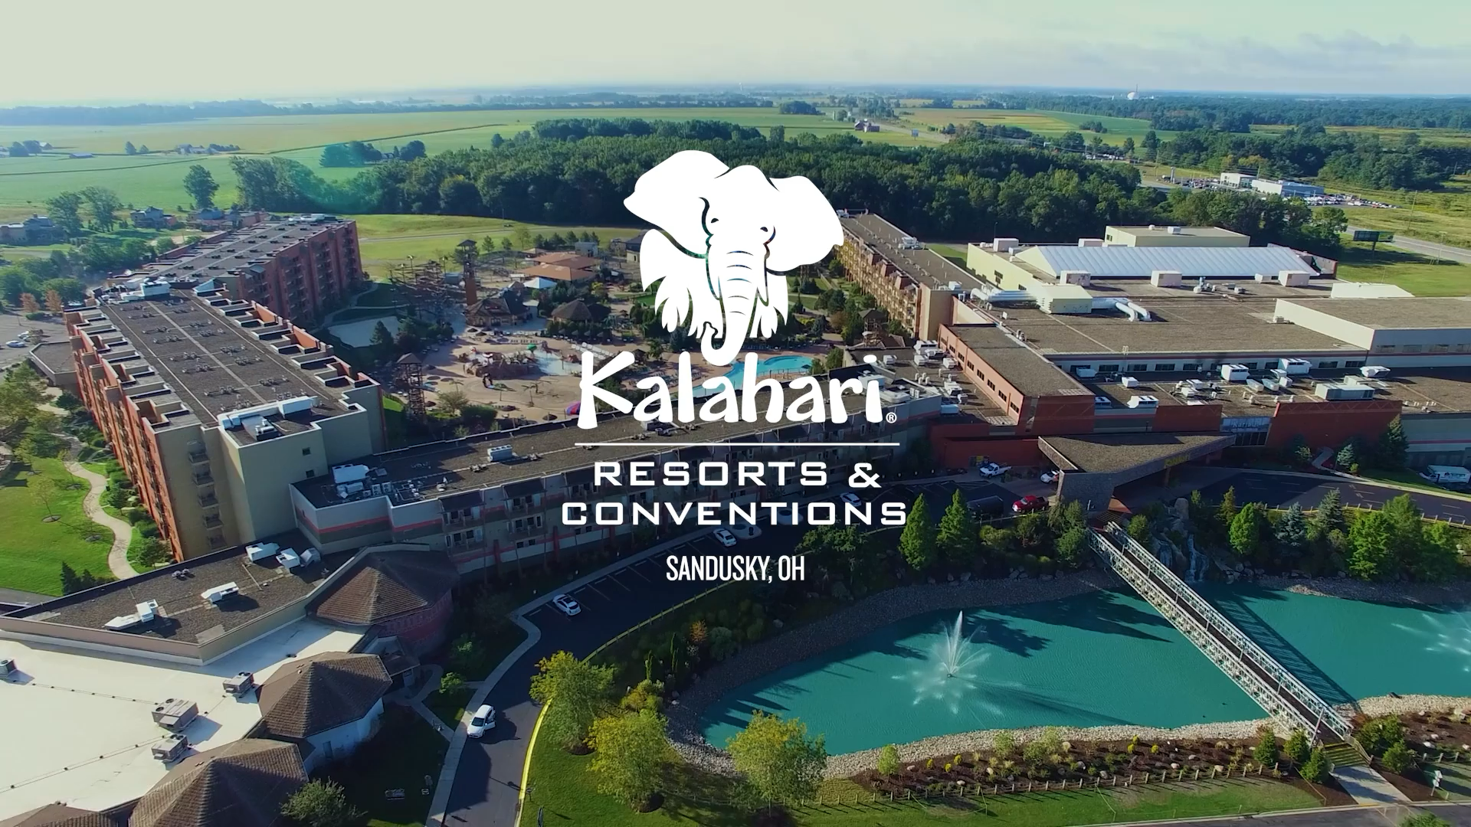
See Why You Should Choose Kalahari
Notes:
Video

Slide 8

Call
855.411.4605
Email
OHGroups@KalahariResorts.com
Website
KalahariMeetings.com
Social
@KalahariMeeting
Visit
7000 Kalahari Drive, Sandusky, OH 44870
Plan Your Event
At Sandusky, OH

